Slide 1
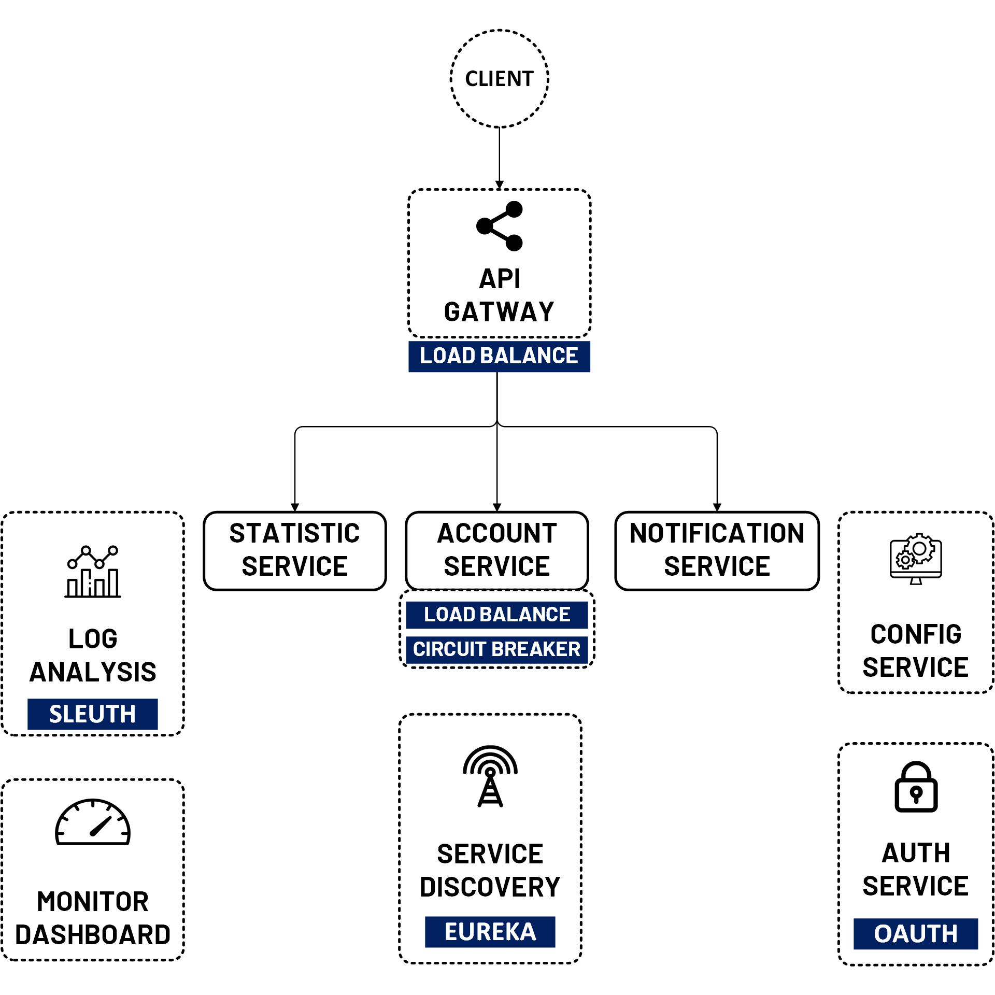

Spring Admin Server & Actuator
www.jmaster.io/course/microservices-with-spring-cloud

Slide 2
Spring Boot Admin
Open source to monitor spring boot applications.
health status, build info, JVM, metrics, Notification, etc.
UI is just a Vue.js application on top of the Spring Boot Actuator endpoints.
Client applications register with admin server via Boot Admin Client (HTTP) or Spring Cloud Discovery

Slide 3
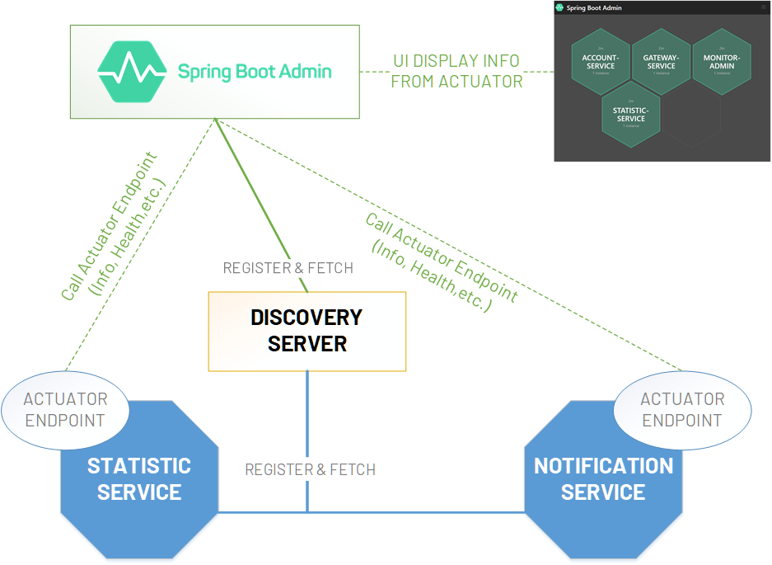

Slide 4
Spring Boot Actuator
Many production-ready features
Expose operational information about the running application — health, metrics, info, dump, env, etc.
Built-in endpoints and more, exposed over HTTP or JMX
Easy configure and customize with spring boot project

Slide 5
Spring Boot Actuator
https://docs.spring.io/spring-boot/docs/current/reference/html/actuator.html
https://codecentric.github.io/spring-boot-admin/2.5.1/#getting-started

